Slide 1
Elements of Literature
tone

Slide 2
Definitions
Tone
The author’s attitude/ feeling about the subject of her writing.
It is the way a writer uses words, creates images, chooses details, uses language, and constructs sentences to present a certain attitude or feeling to the reader about her writing topic.
The tone can be positive, negative or neutral.
It is created through word choice (diction), sentence structure and punctuation.

Slide 3
Example
“Your child can’t read? Can’t do math? Well, maybe he or she has been spending too much time in school and not enough time watching television! Kids in school aren’t learning anything anyway, so they might as well be home watching TV.”
Is the tone positive, negative or neutral?
What is the author’s Tone?
Sarcastic, condescending, accusatory
Negative

Slide 4
Examples
Trees. Who needs them? Yes, they provide essential functions for our eco-system, but beside that, what purpose do they really serve? You have to rake up leaves the fall from them in Autumn, trim their branches when they hit the siding, fear that they’ll fall on your home during a storm, prevent your children from eating the nuts and rotten fruit that fall from them, and chase pests --termites, carpenter ants, and neck-biting squirrels-- out of them. Cut them down and simplify life.
------------------------------------------------------------------------------------
Tall, short, skinny, or wide, California Redwood or Birchwood, trees not only grace the planet with their beauty, but they also use carbon dioxide that would otherwise harm our planet. Without trees, how could we relish in Autumn’s rainbow? We would not longer be able to hear the “swoosh, swoosh, swoosh” as we kick through crisp maple leaves on the sidewalk. Climbing them would be an archaic practice.

Slide 5
Elements of Literature
mood and tone
Just like an author uses word choice and vivid imagery to set tone and mood, movie makers use dialogue, editing, music, and lighting to establish a certain tone and mood within their films…

Slide 6
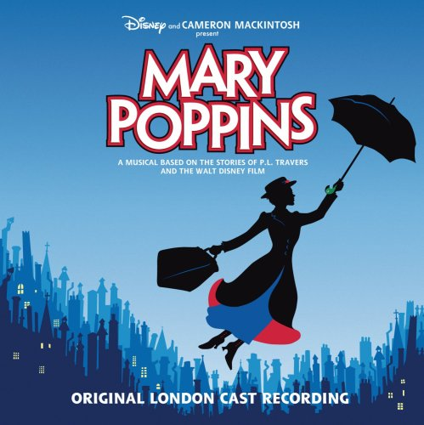
Mary Poppins
First, watch this video trailer for the original film.
Subject: Super-nanny, Mary Poppins, flies in with her umbrella in response to the request of the Banks children and proceeds to put things right with the aid of her rather extraordinary magical powers teaching everyone how to enjoy life. Mary Poppins has both comedy and tenderness and lots of imaginative scenes that are wonderful for adults and children alike. You'll be singing along in no time..."in the most delightful way!"
What is the author/writer feeling?

Slide 7
Mary Poppins RE-CUT
Now, let’s watch a “re-cut” of the film and discuss the author’s new feelings towards a magical nanny flying into the lives of children!

Slide 8
Mary Poppins RE-CUT
What does the “re-cut” version do to the TONE of the film?

Slide 9
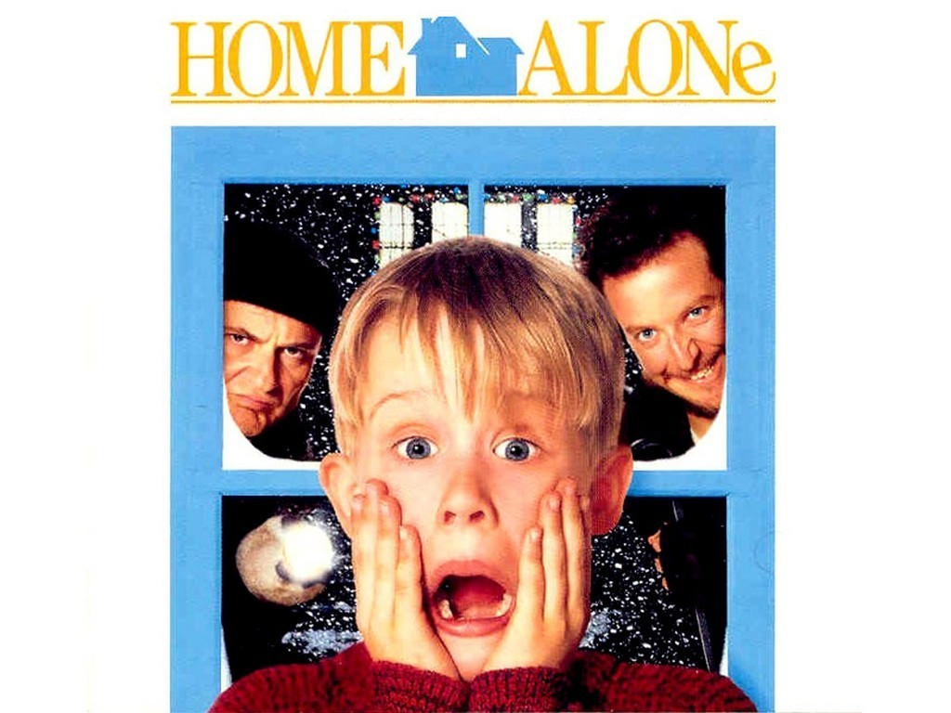
Home Alone
A light-hearted family comedy...

Slide 10
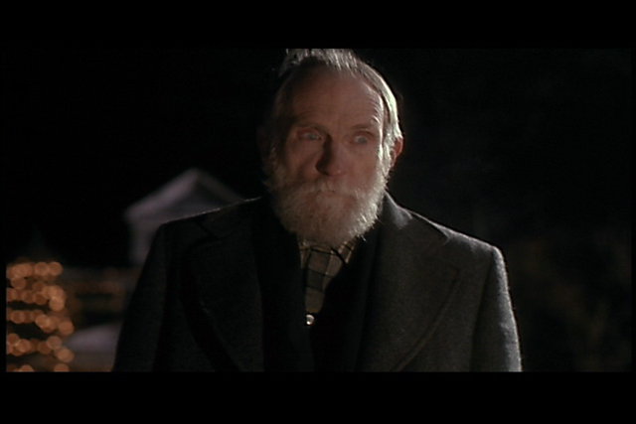
Home Alone RE-CUT
Or…

Slide 11
Home Alone RE-CUT
What does the “re-cut” version do to the TONE of the film?

Slide 12
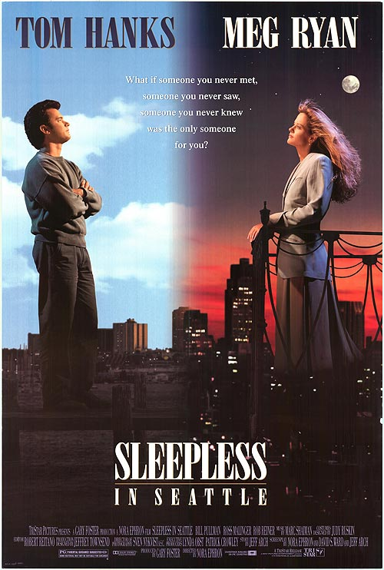
Sleepless in Seattle
A romantic comedy...

Slide 13
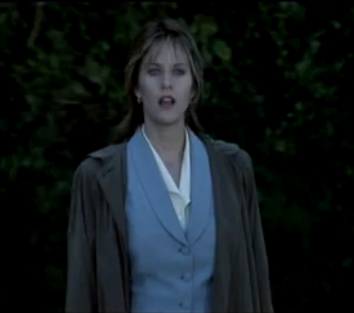
Sleepless in Seattle RE-CUT
Or…

Slide 14
So…
Images on the screen and color tone equal word choice and details a writer chooses to include and focus.
Music equals the rhythm of writing. Short, punchy sentences with attention-grabbing action (verbs) create tension and suspense, just like heavy drums and fast music.

Slide 15
Establish a tone in a paragraph about a seven-year-old sitting on Santa’s lap
Ecstatic Point-of-view:
1st person
3rd person limited
3rd person omniscient
Setting:
Time:
2. Hilarious Place:
Environment:
3. Suspicious Weather
Noise level
4. Embarassed Light level
Characterization
5. Furious Appearance
Actions
6. Annoyed Speech
Thoughts/Feelings
Other characters’ reactions

