Slide 1
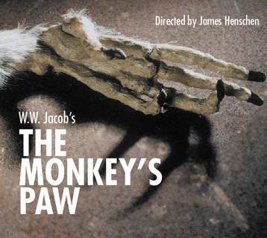
Vocabulary

Slide 2
Amiably
Seeing the mistake he made during their chess game, Mr. White amiably, desired to prevent his son from seeing it.
Amiably: (adv.) With pleasant, good-natured personal qualities.

Slide 3
Grimace
Mrs. White drew back with a grimace, but her son, taking the paw, examined it curiously.
Grimace: (n.) A twisted facial expression indicating disapproval or pain.

Slide 4
Bog
With all of the rain the last several days, the front yard has become a bog.
Bog: (n.) An area of wet, swampy ground.

Slide 5
Condoling
The old man rose, and, opening the door, was heard condoling with the new arrival.
Condoling: (adj.) Expressing sympathy or sorrow.

Slide 6
Presumptuous
The soldier regarded him as in the way that middle age is accustom to regard presumptuous youth.
Presumptuous: (adj.) Excessively confident; arrogant.

Slide 7
Talisman
Mr. White took the talisman from his pocket and held it above his head.
Talisman: (n.) An object thought to have magic powers.

Slide 8
Apathy
In the following days, apathy was the only reaction Mrs. White showed towards her husband.
Apathy: (n.) A lack of interest in or concern for things that others find exciting.

Slide 9
Proffered
Sergeant Major Morris took something out of his pocket and proffered it to Mr. White.
Proffered: (v.) To offer for acceptance.

Slide 10
Frivolous
She spends money on frivolous things.
Frivolous: (adj.) Unworthy of serious attention; trivial.

Slide 11
Fusillade
A perfect fusillade of knocks echoed throughout the house.
Fusillade: (n.) A rapid outburst.

Slide 12
Avaricious
Mrs. White was afraid the money would turn her husband into a mean, avaricious man.
Avaricious: (adj.) Greedy.

Slide 13
Maligned
He darted around the table, pursued by the maligned Mrs. White.
Maligned: (adj.) To have harmful untruths spoken about you; slandered.

Slide 14
Antimacassar
He darted around the table, pursued by the maligned Mrs. White armed with an antimacassar.
Antimacassar: (n.) A protective covering for the backs of chairs and sofas.

Slide 15
Doughty
Sergeant Major Morris spoke of wild scenes, and doughty deeds, of wars and plagues and strange peoples.
Doughty: (adj.) Courageous; brave.

Slide 16
Reverberated
A perfect fusillade of knocks reverberated through the house.
Reverberated: (v.) Echoed over and over.

Slide 17
amiably -avaricious
grimace -maligned
bog -apathy
condoling -reverberated
presumptious -frivolous
talisman -doughty
fusillade -antimacassar
proferred

